Slide 1
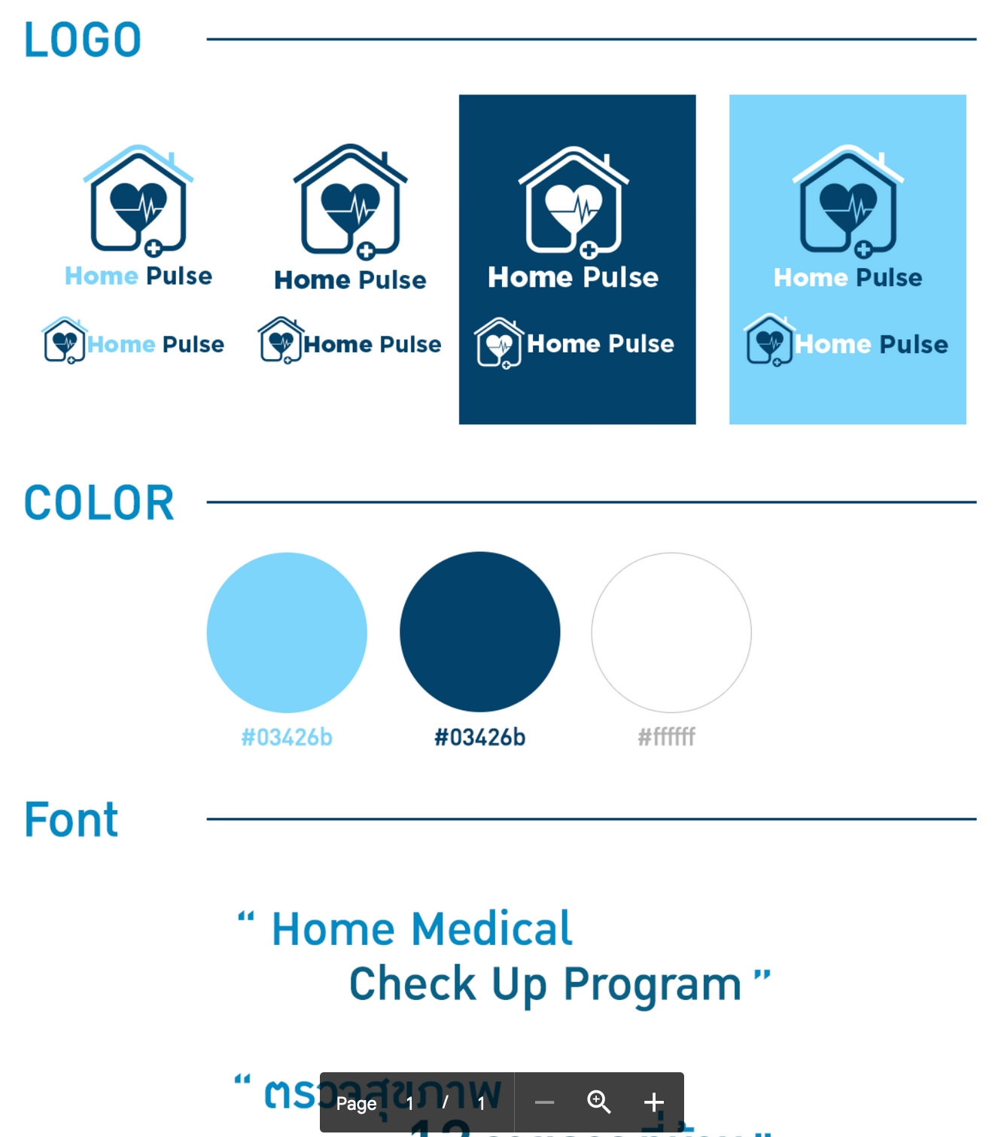



2023 START Global Summit: DKSH Hackathon case Design guidelines
Sample logo options
Please choose from available files in design toolkit

